Slide 1




Gold Sponsors

Slide 2

the wonders of modern SQL administration
…with Powershell and dbatools
presented by @nvarscar

Slide 3

about:me
Kirill Kravtsov - @nvarscar
SQL Server DBA at Wawanesa Insurance
10 years of SQL Server experience
DB Engine, SSRS, SSIS, SSAS
Automation – Powershell, T-SQL
Adept of DevOps in databases

Slide 4
agenda
Why would I use Powershell?
Powershell 💖 SQL Server
dbatools
About
Installation
Navigation and help
Demo

Slide 5
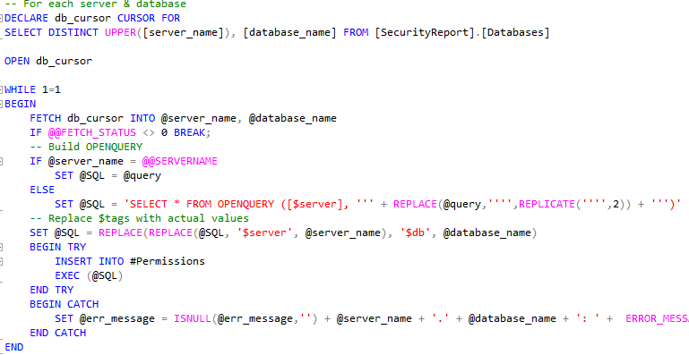
why can’t we just use native sql tools?
GUI (SSMS, Configuration Manager)
Excellent tool to perform instance configuration and execute queries
Some things can only be done through T-SQL
Endpoint configuration, backup history, snapshots, search definition, sp_configure
No bulk operations
T-SQL
Well suited for data operations; not so much for configuration and maintenance
Queries against a set of servers are difficult to implement
Linked Servers, OPENROWSET, foreach operations
Limited exposure to underlying OS
including interactions with third-party applications
Some operations cannot be performed purely via T-SQL
AlwaysOn, SSIS Catalog, Data Collection, Maintenance Plans

Slide 6

when ps stands out?
Multi-server management
Handles arrays of objects with ease
Code re-use
Combining results from multiple sources
Interactions with other applications and OS
Starting processes
Processing output
Using .Net classes natively
Automation
Maintenance
Reporting
Testing
….

Slide 7
ps basics
Variables
$myVariableName = …
Arrays
Can be defined by:
Comma-separated list of values: 1,2,3,4
@() notation: @(‘asd’,’sdf’,’dfg’)
Members can accessed by using
square brackets
ForEach enumeration
Member properties can be accessed using ‘dot’ notation
Returns array as well!
Hashtables
A dictionary of key=value pairs
Defined by @{} notation
Can be used for parameters splicing ->
$ps = Get-Process
$ps[0]
$ps | ForEach-Object { $_ }
foreach ($p in $ps) { $p }
$a = Get-Process; $a.Name
$params = @{
Path = 'C:\Temp'
Include = '*2017*'
Recurse = $true
}
Get-ChildItem @params

Slide 8
ps conditioning
If(condition){script}…elseif(condition){script}…else{script}
Comparison operators
-eq
-ne
-gt
-ge
-like / -notlike “*”
-match / -notmatch
-contains / -notcontains / -in / -notin
if (1 –eq 0) { 1 }
elseif (2 –eq 0) { 2 }
else { 3 }

Slide 9
ps commands
Powershell command
Verb-Noun notation: Get-Process; Set-Parameter
Outputs an object
Can accept pipeline input
Can be followed by parameters:
Switch
Named
Positional
> Get-ChildItem C:\Temp -Include *2017* -Recurse

Slide 10
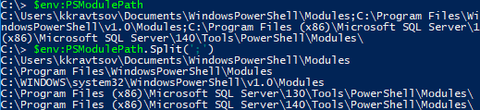
ps modules
Module
A set of related PowerShell functionalities, grouped together as a convenient unit
Contains script files and assemblies we can use in our code once the module is loaded
How to install/load module:
Run Import-Module <path>
Put module folder into one of the directories specified in: $env:PSModulePath

Slide 11

when you get lost
Get-Help <Command-Name>
Shows basic usage information
Useful switches:
-Detailed – to show parameter details and examples
-Online – opens a web-page dedicated to this command
<Some Powershell statement> | Get-Member
Outputs all methods and properties of an object
Accessing object properties
Using “dot” notation:
Using Select-Object:
> (Get-Process).Name
> Get-Process | Select-Object Name, CPU

Slide 12
native powershell module SqlServer(aka SQLPS)
Developed by Microsoft
Supplied with SQL Server SMO assemblies (dlls )
Introduces new root drive SQLSERVER:\
You can access instances using the path notation: SQLSERVER:\SQL\ServerName\InstanceName
Initially distributed with SSMS, now available in PSGallery
Install-Module SqlServer

Slide 13
sql server management objects
SMO
Microsoft.SqlServer.Management
.Smo
.NotificationServices
.RegisteredServers
.Trace
.Server
.Agent
.Broker
.Mail
.Wmi
…

Slide 14
community ps modules
Download and install
Download as an archive from PSGallery and extract
Download/clone from any source into a local folder
Install-Module (Powershell 5.0+) – automatic download from PSGallery
SQL Server-related modules:
SQLPSX – managing different aspects of SQL Server through Powershell
PowerDoc – discover, document, and diagnose your environment
dbareports – gathering data and analyzing your environment using Powershell and SSRS/Power BI reports
dbatools – helps DBAs to be more productive: automating numerous tedious tasks

Slide 15
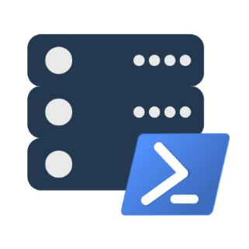
dbatools ps module
Created by DBAs for DBAs
Free, open-source and community-driven
Started as a database migration solution
Over 500 commands automating multiple aspects of DBA’s life:
Move entities between environments (databases, logins, parameters, etc.)
Tests and verifications
Statistics
Configuration
… and so much more

Slide 16

dbatools installation
Powershell Gallery: Install-Module dbatools
Invoke-Expression (Invoke-WebRequest -UseBasicParsing https://dbatools.io/in)
Download the zip directly and manually import the module.
Clone the repository from GitHub: git clone https://github.com/sqlcollaborative/dbatools
More info: https://dbatools.io/download/

Slide 17



dbatools: navigation and help
Function names: <Verb>-Dba<Noun>, e.g.: Get-DbaLogin Test-DbaConnection
Find-DbaCommand pattern
Web-site: https://dbatools.io/functions/
Get-Help function-name
Slack: http://sqlcommunity.slack.com #dbatools
Invitation: https://dbatools.io/slack/

Slide 18
DEMO

